Slide 1


Open Source
Solutions for SMEs
Focus: Software
Productivity
Collaboration
Remote Access
Community

Slide 2

Open Source
Solutions for SMEs
It’s me again!
LeROIFOPESON
Information Systems & Technology Consultant
Linux Professional Institute (LPI-2) Certified
Used MS/PC DOS, Windows 3, 95, 98, XP & 7
(XP was my favorite)
Switched to Linux
Abimbola Adefope

Slide 3
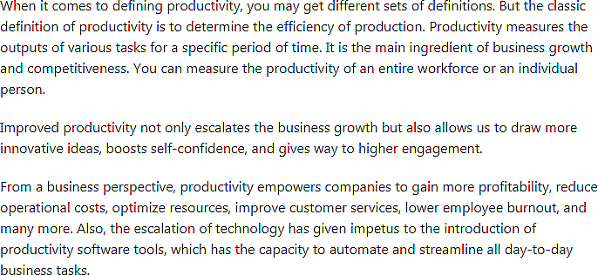
Open Source
Solutions for SMEs
Productivity
Source:
Goodfirms.co

Slide 4

Open Source
Solutions for SMEs
Achieving Productivity Targets
Automated business operations
Business tools that provide real-time business intelligence to users
Employees & Teams using integrated, collaborative software
Cost-effective, scalable enterprise open source tools
Multi-platform enabled solutions
Time usage capturing fools to determine efficiency
Security built-in
Ease of use

Slide 5
Open Source
Solutions for SMEs
Integrated business software - Core
The core components of a robust business software infrastructure include
Office applications suite
Project Management
Accounts
Human Resources Management
Communications
Collaboration
There are robust integrated open source solutions that provide most of these services in one package at little or no initial cost.
These are enterprise-ready, but can also be deployed for by SMEs.
The early adoption of these software solutions can have long term benefits to business development & growth.

Slide 6
Open Source
Solutions for SMEs
Integrated business software - Features
A useful productivity tool will include many of the following functionality & services:
Easy to use for collaboration
Intuitive & easy to learn
Seamless integration & management
Secure with role-based access levels
Robust community support
Cloud-ready or scalable
Device agnostic – compatible
Flexible
Free or cost effective
Multifunctional
Employee & Team efficiency tracking
Client service management
Project management & reports
Generate professional reports
Appointment calendars
Productivity assessment
Cost management

Slide 7
Open Source
Solutions for SMEs
Integrated business software – Open source
LibreOffice, Apache OpenOffice - Word processor, Database, Spreadsheet, DTP
OpenProject - Project Management
Odoo, OF Biz, xTuple Postbooks - ERP, Accounting, Point of Sale
SugarCRM, OpenCRX - CRM
Bitrix24, OrangeHRM - HR Management Software
Mattermost, Element, Rocket.Chat - Communications.

Slide 8
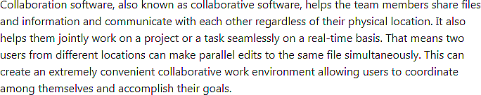

Open Source
Solutions for SMEs
Collaboration
Source:
Goodfirms.co

Slide 9
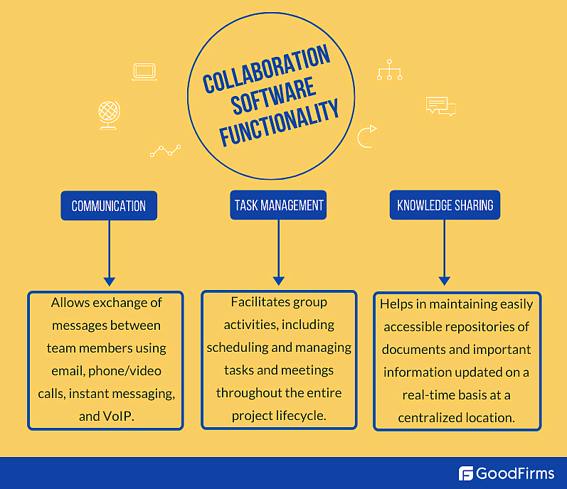
Open Source
Solutions for SMEs
Collaboration software
Key Features:
Accessible from anywhere
Instant messaging – email & chat
Video conferencing
Secure information creation & sharing
Synchronous document management
Scheduling & appointments calendars
Online interactive whiteboards
Centralized repository of data
Open source tools:
Kolab
OpenProject
OpenPass
Group Office
Collabtive
Cyn.in
Benefits:
Better team communication
Better team cohesion
Rapid results delivery
Better productivity
Better workflow

Slide 10

Open Source
Solutions for SMEs
Remote Access
Key Features:
Secure & stable connection
FTP file sharing
Multiple computer connectivity
Session recording
Easy to use
Source:
Goodfirms.co
Open source tools:
TightVNC
Xrdp
X2Go
Nomachine
Xpra

Slide 11
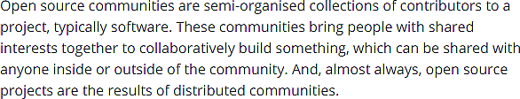


Open Source
Solutions for SMEs
Community
Source:
Techradar.com
GitHub
StackOverflow

Slide 12
Open Source
Solutions for SMEs
Open source Business Software repositories
Alternativeto.net – Suggests alternative software for proprietary applications
Goodfirms.co – Open source, free & non-free software site
Open source resources
Opensource.com – Knowledgebase for open source technology & tools

Slide 13
Open Source
Solutions for SMEs
A call for feedback
To derive the greatest benefit from these seminars, one must explore some of the tools mentioned as they apply to your area of need or specialty.
The experiences garnered will be useful, not only in determining the best tools in any use case, but also determines the need for support through focused deep dives and possibly demonstrations, in subsequent sessions.
So, kindly explore and give us your feedback before the next session.
Thank you for listening.

